Slide 1
Parts Tech AI
Gerardo Alcocer Mathilde Vankelegom Oscar Chavez

Slide 2
Objectives
Facilitate the look up of automotive parts.
Create a natural interaction, such as a conversational experience.
Avoid entry barriers like downloading an app.

Slide 3
Goals
Integrate the PartsTech API
Create a chatbot on top of the API.
Use NLP to differentiate entities
Create a smart chatbot.
Allow clients to find or quote automotive parts
Track new and potential clients.

Slide 4
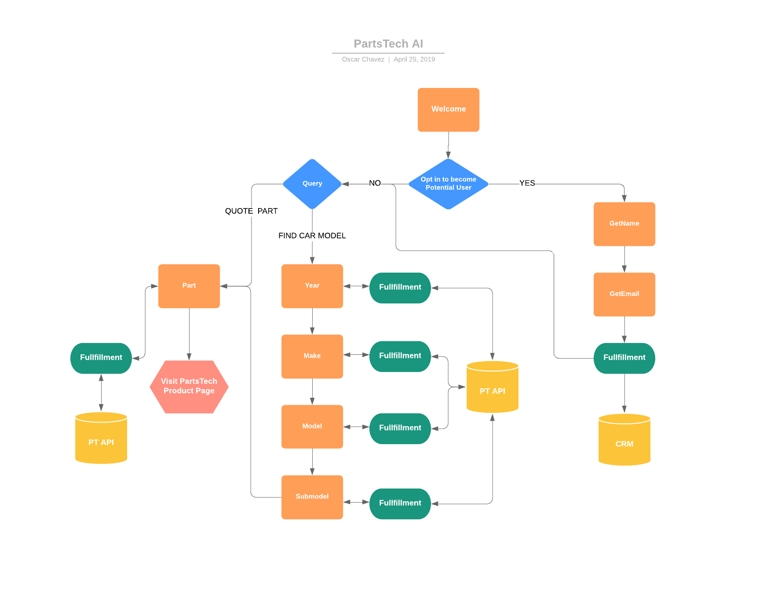
Flow

Slide 5







Architecture
Presentation Layer
Business Layer
Data Layer
Telegram
RESTful API
Dialogflow
Agent
Cloud Functions
Phone Interface

Slide 6
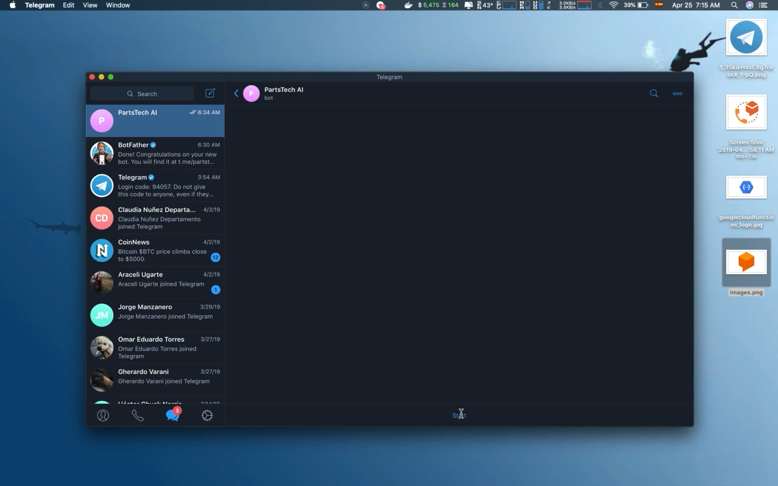
Demo

Slide 7
Github
https://github.com/oschvr/partstechai

Slide 8
Links
https://bot.dialogflow.com/507aa16c-9eaa-42cb-a341-aed4527cd3a7
+1 323-364-5637

